Slide 1
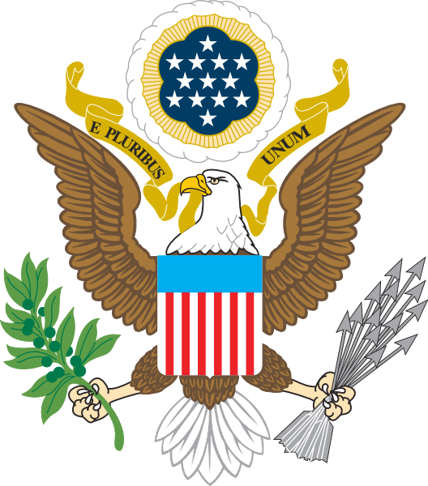
OBJECTIVE
Hmmmm…
You will be able to explain the causes and effects of America’s early conflicts with foreign countries.
Describe what you see in the picture below. What do the different parts of this picture represent?

Slide 2
E. Pluribus Unum Out of many, we are one.
The bald eagle has come to be a symbol of the United States.
Why is it an eagle?
What is the eagle holding?
What do these items represent?
Why is the eagle looking to the left?

Slide 3
Foreign Policy
Dealing with Other Countries
We learned last week that George Washington, our first president, preferred the policies of “isolationism.” But could we be isolationists (neutral) forever?
When John Adams and Thomas Jefferson took over the office of President, our foreign policy was forced to change!
Fill in your notes as we discuss…

Slide 4
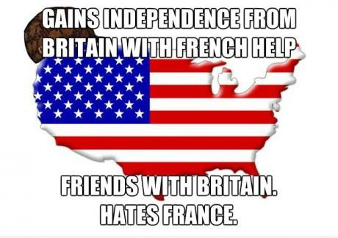
Foreign Dilemma #1:
What should President Adams do to protect American ships?
President John Adams soon realized after he became president that staying isolated and neutral with the nation of France was nearly impossible
The French had always viewed the British as their natural enemies. When America formed an alliance with England, France saw this as a betrayal. In response, they began attacking American merchant ships.
Throughout the year 1797, France attacked and seized over 316 American ships.

Slide 5
The XYZ Affair
To deal with the French, President Adams sent three diplomats, or representatives, to France to end the attacks. To insult the Americans, the French Minister refused to meet with the diplomats and instead sent secret agents—known as X, Y, and Z—to meet with the Americans.
The French X, Y, and Z secret agents demanded that the Americans pay France a bribe to get them to stop attacking American ships. In response, the Americans REFUSED to pay anything to France and reported this back to the President.
President Adams decided to recruit an army and use American ships to attack the French at sea. Though war was never declared, this show of strength showed the world that America would not take abuse without fighting back!

Slide 6
The XYZ Affair. Scandalous!

Slide 7
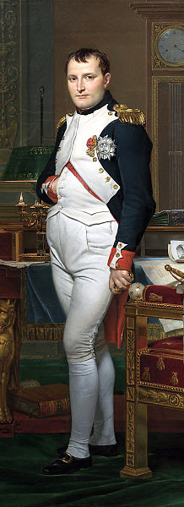
War or Peace?
Arrows or the Olive Branch?
President Adams knew that he could declare a war with France and have the support of many angry Americans. Adams also knew, however, that war would not be good for America and that it was in our interests to keep peace with the French.
When Napoleon took over France in 1799, he was ready to make peace with America and agreed to stop attacking our ships at sea.
President Adams chose the olive branch instead of the arrows to solve our first foreign dilemma!

Slide 8
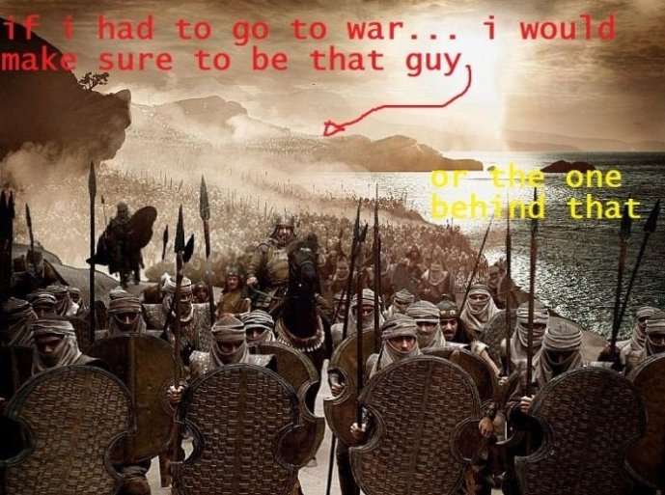
Check your Understanding!
Why was it so difficult for America to remain “isolationist”?
How did President Adams solve this dilemma—with arrows or an olive branch?

Slide 9
Foreign Dilemma #2:
How should President Jefferson deal with kidnapping and pirates?
When France and Britain entered war with each other, they insisted that America take a side! When Jefferson took office, he wanted to practice isolationism and stay out of Europe’s drama.
Unfortunately, France and England would not allow for American neutrality. Both countries started attacking American ships if they attempted to trade with the enemy country.
Both England and France started impressing, or kidnapping, American sailors and forced them to serve in the British or French navy!

Slide 10
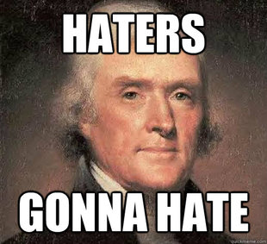
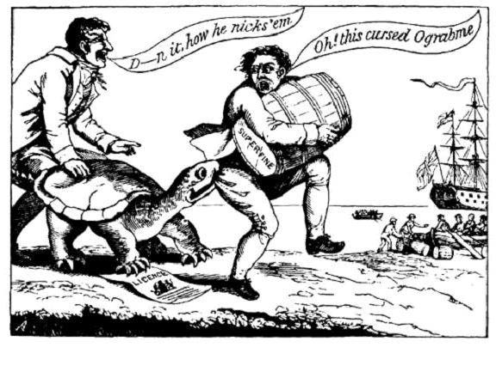
Trade Embargo!
To stop France and Britain from impressing, or kidnapping, American sailors, President Jefferson proposed an embargo—a complete end to all trade with France and Britain.
Jefferson hoped that this embargo would hurt France and Britain and it would convince them to stop the impressment of Americans.
Unfortunately, Jefferson realized that Americans hated this embargo more than anyone else—it hurt the American economy and cursed Jefferson by calling it the “o-grab-me”—embargo spelled backwards ☺
Eventually, Congress repealed Jefferson’s embargo, but the French and British continued to attack American ships.

Slide 11
Check your Understanding!
Did Jefferson use the arrows or the olive branch to deal with England and France?
What does this cartoon say about how Americans felt about Jefferson’s embargo?

Slide 12
ACTIVITY: XYZ Affair Comic Strip
DIRECTIONS: Create a comic strip that illustrates what happened during the XYZ affair.
The first box should illustrate the CAUSE of the problem
The second box should show me what happened during the XYZ affair
The third box should show me how President Adams responded to the XYZ affair.
Be sure to use color and write a caption explaining each picture you drew!

Slide 13
Trade Embargo!
DIRECTIONS: Create a comic strip that illustrates what happened during the trade embargo.
The first box should illustrate the CAUSE of the embargo
The second box should show me what the embargo did to America’s economy
The third box should show me how Americans responded to the embargo.
Be sure to use color and write a caption explaining each picture you drew!
Use your notes to make sure you are accurate!

