Slide 1
Thomas Jefferson Guided Notes
Objective
SWBAT understand the significance of a New Party in Power & Marbury vs. Madison, through a series of image and quotation analysis

Slide 2
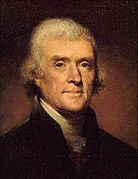
THOMAS JEFFERSON
After many votes in the House, Jefferson was chosen to be president.
I win!

Slide 3

A new party in power
REVOLUTION OF 1800 TIED VOTE
Jefferson (Duck) beats Adams (falcon) and...
This was a big deal because…
Power was transferred from one party to another PEACEFULLY

Slide 4
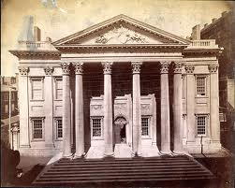

Federalists policies he kept
He wanted to keep the country from being TOO divided SO he kept a few of the Federalists’ policies:
  Keeps National Bank
  Keeps paying off debt with federal money
  Allows many Federalists to keep their government jobs

Slide 5
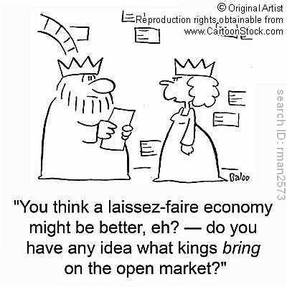
THOMAS JEFFERSON
Laissez-faire: Hands off – usually refers to the “hands off’ approach the gov’t takes with economics
REVOLUTION OF 1800
Jefferson (Duck) beats Adams (falcon) and establishes new policies:
-tries to cut federal budget & reduce federal debt
-Promotes lassiez-faire policies in economic affairs
Decreases sizes of government departments, army & navy

Slide 6
Answer the question below
How did Jefferson’s election in 1800 mark a change in the nation?
What are some changes Jefferson made as president?
What do you think is the BIGGEST difference between Democratic-Republicans & Federalists?

Slide 7

MarBury Vs. Madison
Midnight Judges
On the last night of Adams’ presidency, appointed FEDERALIST Marbury as a justice on the Supreme court. James Madison, the Secretary of State, refused to deliver the message to Marbury before Adams’ time was up.

Slide 8
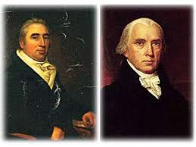

MarBury Vs. Madison
Midnight Judges
Marbury sued Madison claiming that under the JUDICIARY ACT of 1789 the Courts ordered Madison to deliver it, so he should have
Jefferson Should have a say in this!!
…-_-
It’s MY job!! The Court ORDERED IT!! I should have it you nitwit!!!
%#$#$%^&*#$%*!!

Slide 9
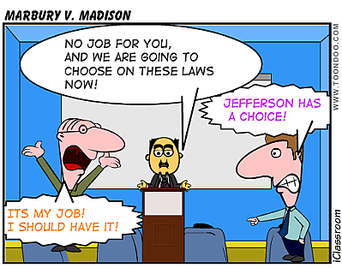

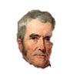
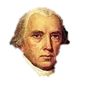
MarBury Vs. Madison
Midnight Judges
John Marshall (another FEDERALIST) ruled AGAINST Marbury stating that the Judiciary Act of 1789 is UNCONSTITUTIONAL

Slide 10
Marbury vs. Madison
EFFECT:
Established Judicial Review
Gave the Supreme Court the power they have today
Judicial Review: the power to reject laws that were unconstitutional

Slide 11
N.U.R.S.E
What was Jefferson’s opinion about Marbury vs. Madison?
“The opinion which gives to the judges the right to decide what laws are constitutional and what not, not only for themselves…but for the Legislature and Executive also…would make the judiciary a [tyrannical] branch”
-Thomas Jefferson, letter to Abigail Adams, 1804

Slide 12
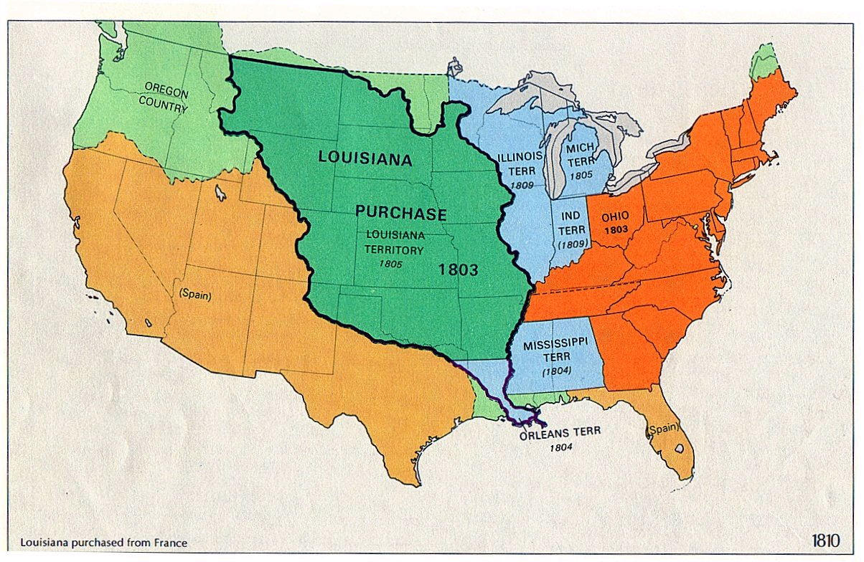


THOMAS JEFFERSON
Louisiana Purchase
Wanted to expand WEST
1803, Napoleon Bonaparte, the new ruler of France sold the Louisiana Territory for 15 million dollars (3-4 cents per acre!)
Not really constitutional!!! (Bad Ducky!!)
Doubled the size of the United States
$15 millions

Slide 13
Louisiana purchase
Why did Jefferson purchase Louisiana?
Why did this go against the Demo-Rep. beliefs?
Why did he do it anyway?

Slide 14
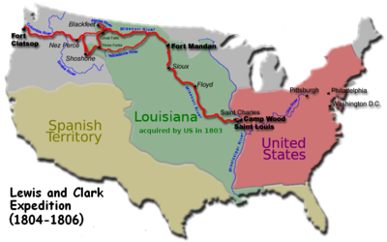
THOMAS JEFFERSON
Lewis and Clark Expedition
Explorers who mapped path to Pacific Ocean
Sacagawea was a 15 year old Shoshone Native American guide

Slide 15

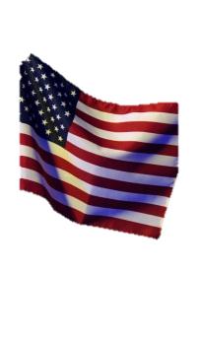
Embargo Act of 1807
British would stop U.S. ships to search for deserters & would sometimes impress Americans to serve on the British ships.
Deserters: people who ran away from military duty
Impressment: forced military service

Slide 16
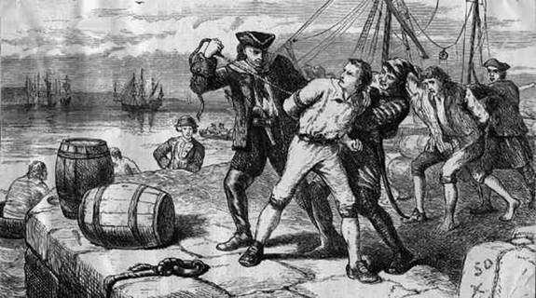

Slide 17
Embargo Act of 1807
To avoid war, Jefferson pushed the Embargo Act of 1807—American ships were not allowed to trade with European nations. This was later replaced with the Non-intercourse Act (1809) that lifted the embargo
Bad decision
Prevented trade with Britain and France – why bad?
REPEALED in 1809

Slide 18
