Slide 1
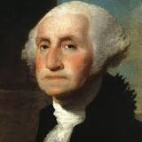
I. Brain Dump
Know | Want to Know | Learned
- George Washington fought as the commander of the Continental Army | - How did he manage to lead a group of soldiers that never really trusted him until halfway through the American Revolution? | AT HOME you will fill in this portion: -I learned that he had help from von Stueben and Lafayette to help train the army as well as make strategies throughout the war—with every victory came more trust.
What do you know about this man?
Write down EVERYTHING you KNOW about
Write down what you WANT to KNOW about
He was a good general
He was a general
IDK/
Nothing
Was it difficult being a general?

Slide 2
Guided Notes
I. Leadership
VI. Hamilton’s Policies
V. Neutrality
II. Terms
III. Washington’s Cabinet

Slide 3


I. Leadership
Scenario: Your neighborhood is putting together an official soccer team and need you to be the captain.
What would it take to be a good leader?
What kind of things/help would you need to do in order to be an effective team captain?

Slide 4
Guided Notes
I. How do you feel
VI. Hamilton’s Policies
V. Neutrality
II. Terms
III. Washington’s Cabinet

Slide 5
Terms
Precedent - an action taken for the first time, which is followed by others afterwards
Domestic policy
Foreign Policy
Cabinet

Slide 6
Precedent
Warm-ups:
  50 suicides
  50 push-ups
  50 frog jumps
Every practice
After you leave, the team
Still does that warm up =
You’ve set a precedent

Slide 7
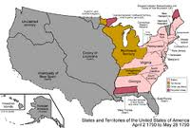
Terms
Precedent - an action taken for the first time, which is followed by others afterwards
Domestic policy – refers to government policies dealing with conditions within the nation
Foreign policy –
Cabinets –

Slide 8
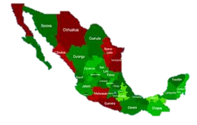
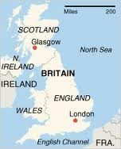
Terms
Precedent - an action taken for the first time, which is followed by others afterwards
Domestic policy – refers to government policies dealing with conditions within the nation
Foreign policy – concerns or relations with other countries
Cabinets –

Slide 9
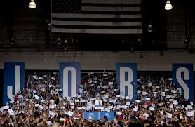
Domestic or Foreign?

Slide 10
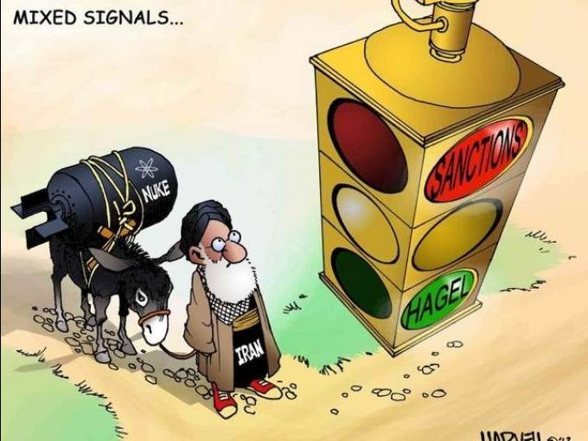
Domestic or Foreign?
Economic Ban on goods from other nations

Slide 11
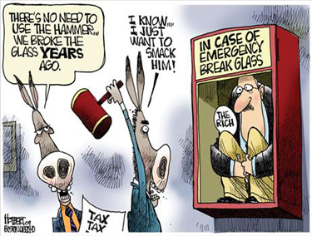
Domestic or Foreign?
TAXES

Slide 12
Terms
Precedent - an action taken for the first time, which is followed by others afterwards
Domestic policy – refers to government policies dealing with conditions within the nation
Foreign policy – concerns or relations with other countries
Cabinets – a group of officials in charge of executive departments

Slide 13
Guided Notes
I. How do you feel
VI. Hamilton’s Policies
V. Neutrality
II. Terms
III. Washington’s Cabinet

Slide 14
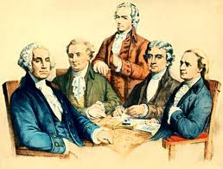
Washington’s Cabinet
Precedents created by Washington:
Created a cabinet for the Presidency
Two terms as president (4 year terms)
Farewell Address

Slide 15
Guided Notes
I. How do you feel
VI. Hamilton’s Policies
V. Neutrality
II. Terms
III. Washington’s Cabinet

Slide 16
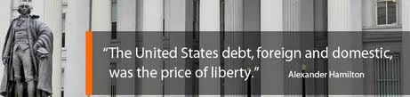
Hamilton:
Underline what I underline and circle as I circle
Liberty costs something = DEBT
we have debt because we wanted liberty

Slide 17
After the American Revolution
National Government (gov’t) owed:
States owed:
$54 million
$78 million
$24 million

Slide 18
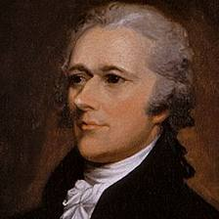
Hamilton’s Financial Plan
Repay the Debt
National Gov’t pay both national & state debts
National Bank
A place to deposit taxes, provide sound currency & make loans to the national gov’t
Whiskey Tax
Way to raise money from western farmers
Protective Tariff
Tariff- a tax on imported foreign goods which would protect American industries from foreign competition

Slide 19
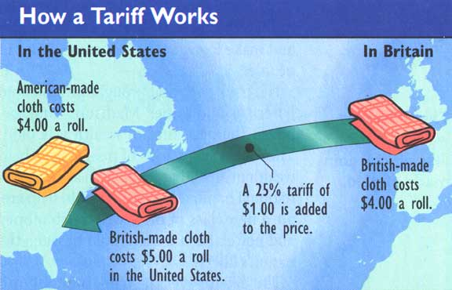
Tariff – a tax on imported foreign goods which protect American industries from foreign competition

Slide 20
Hamilton’s Financial Plan
Repay the Debt
National Gov’t pay both national & state debts
National Bank
A place to deposit taxes, provide sound currency & make loans to the national gov’t
Whiskey Tax
Way to raise money from western farmers
Protective Tariff
Tariff- a tax on imported foreign goods which would protect American industries from foreign competition

Slide 21
Washington’s Cabinet
Thomas Jefferson,
Sec. of State

Slide 22
Hamilton’s Financial Plan
To create a stable economic system, Alexander Hamilton, the Secretary of the Treasury, set out an economic plan in which the federal government would both assume the debts of the national and state governments, and create a national bank, a whiskey tax, and a protective tariff to help American manufacturers.
All of Hamilton’s Financial Plan was accepted except for the tariff

Slide 23
N.U.R.S.E
“A national debt, if it is not excessive, will be to us a national blessing”
  -Hamilton
  What does Hamilton mean?
National debt (if not extreme) will be good for the nation
Extreme

Slide 24
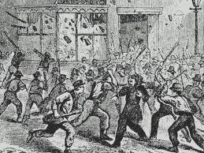
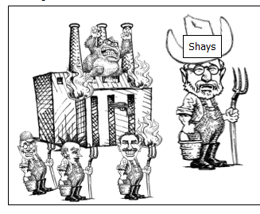
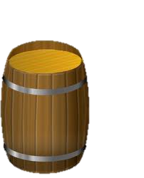

Whiskey Rebellion (1794)

Slide 25
Guided Notes
I. How do you feel
VI. Hamilton’s Policies
V. Neutrality
II. Terms
III. Washington’s Cabinet

Slide 26
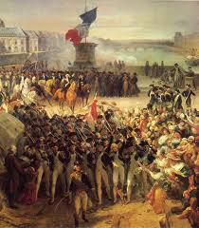
French Revolution

Slide 27
Use N.U.R.S.E to answer the questions
“It appears that a state of war exists between Austria, Prussia, …..Great Britain and the Netherlands on the one part, and France on the other. The duty and interest of the United States require that they should adopt a conduct friendly and impartial toward the [warring] powers. I have though fit to declare the position of the United States to observe a conduct towards those powers respectfully; and warn our citizens to avoid all acts which may in any manner tend to [go against] this position”
In your own words, describe Washington’s Proclamation of Neutrality
Do you think Washington chose a wise policy? Explain

Slide 28
Policy of Neutrality
George Washington wanted the nation to stay neutral.
He believed American should not become involved in the conflicts of foreign nations

Slide 29
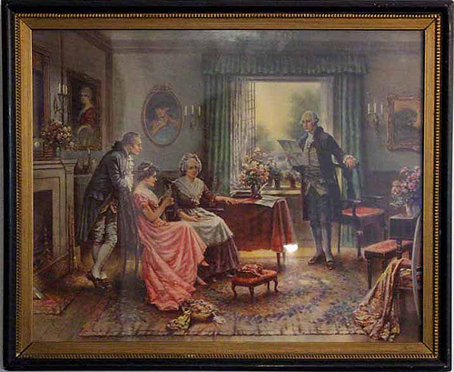

Slide 30
Farewell Address
Rejected running for a 3rd term – (only served 2 terms as president)
gave a speech warning the nation
  Relations between the North & South
  Importance of remaining Neutral
  Warning against the rise of political parties
Precedent

Slide 31
N.U.R.S.E
“ The great rule of conduct for us in regard to foreign nations is …to have with them as little political connection as possible. …to steer clear of permanent alliances with any portion of the foreign world”
- George Washington, Farewell Address
A great rule of behavior to follow is not getting involved with foreign nations and avoiding permanent partnerships
behavior
Deals/partnership
What is the danger that Washington cautioned the nation against in this quote?

Slide 32
Origins of U.S. Political Parties
Objective: Examine and evaluate the origins of early political parties.
Terms
Political Party Leaders
Growing Differences

Slide 33
TERMS
Partisan: firmly favoring one party or faction
Caucuses: a meeting of members of a political party to choose candidates for upcoming elections

Slide 34
Thomas Jefferson
Alexander Hamilton

Slide 35




Democratic
Republicans
Federalist
Anti-Federalists

Slide 36
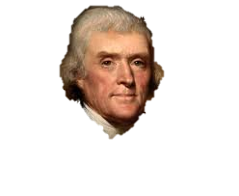
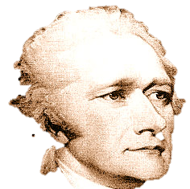
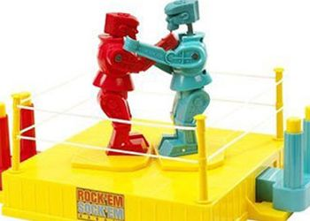
Alexander Hamilton
Thomas
Jefferson
Federalist
Democratic-
Republicans

Slide 37
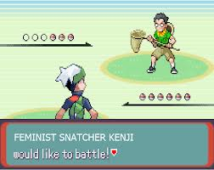
Hamilton the Federalist & Jefferson the Democratic Republican

Slide 38
Rise of Political Parties
Federalist | Democratic-Republican
Sought a strong CENTRAL Government | Sought stronger STATE government
Favored manufacturers and merchants | Favored self-sufficient farmers
Loose construction of the Constitution | Strict construction of the Constitution
Supported a national bank | Opposed a national bank

Slide 39




Use the chart and your knowledge of social studies to answer the following question
Federalist | Democratic-Republican
Sought a strong central Government | Sought stronger STATE government
Favored manufacturers and merchants | Favored self-sufficient farmers
Loose construction of the Constitution | Strict construction of the Constitution
Supported a national bank | Opposed a national bank
What conclusions can best be drawn from the information in this chart?
  Political parties usually agree on most issues
  The Federalists opposed most tariffs
  The Democratic-Republicans favored a strong national bank
  Political Parties often have differing visions of the nation’s future

Slide 40
Election of 1796
Federalist Candidates | Democratic Republican Candidates
John Adams | Thomas Jefferson
Charles Pinckney | Aaron Burr

Slide 41
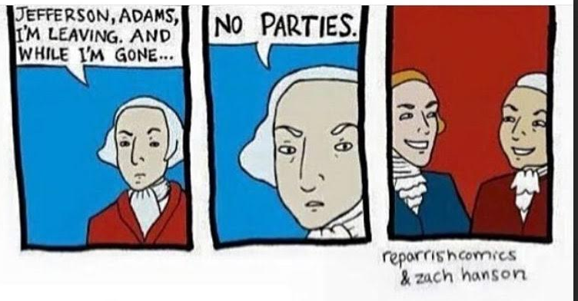
Washington’s Farewell Address

Slide 42
First Political Campaign
Using your notes, textbook pages 262-264, and online resources
Create one of the following to represent one of the lead candidates for president in the 1796 Election:
  Campaign Poster for one Candidate
  30 second campaign commercial
  30 second speech about why they would be a good Candidate

