Slide 1
Party Politics
The Origins of American Political Parties

Slide 2
Origins of U.S. Political Parties
Objective: Examine and evaluate the origins of early political parties.
Terms
Political Party Leaders
Growing Differences

Slide 3
TERMS
Partisan: firmly favoring one party or faction
Caucuses: a meeting of members of a political party to choose candidates for upcoming elections

Slide 4
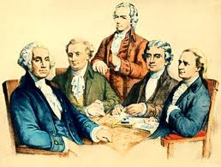
Thomas Jefferson
Alexander Hamilton

Slide 5
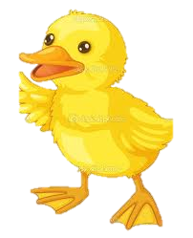
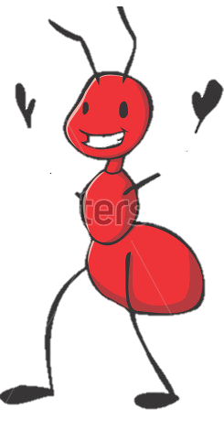


Democratic
Republicans
Federalist
Anti-Federalists

Slide 6
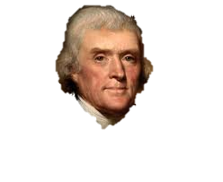
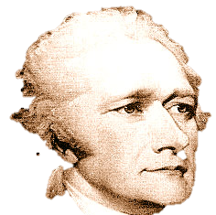
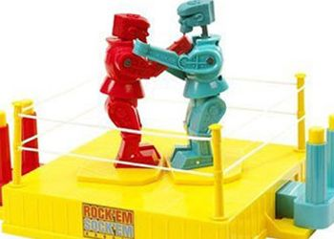
Alexander Hamilton
Thomas
Jefferson
Federalist
Democratic-
Republicans

Slide 7
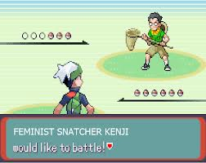
Hamilton the Federalist & Jefferson the Democratic Republican

Slide 8
Rise of Political Parties
Federalist | Democratic-Republican
Sought a strong CENTRAL Government | Sought stronger STATE government
Favored manufacturers and merchants | Favored self-sufficient farmers
Loose construction of the Constitution | Strict construction of the Constitution
Supported a national bank | Opposed a national bank

Slide 9


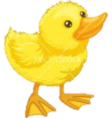
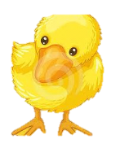
Use the chart and your knowledge of social studies to answer the following question
Federalist | Democratic-Republican
Sought a strong central Government | Sought stronger STATE government
Favored manufacturers and merchants | Favored self-sufficient farmers
Loose construction of the Constitution | Strict construction of the Constitution
Supported a national bank | Opposed a national bank
What conclusions can best be drawn from the information in this chart?
  Political parties usually agree on most issues
  The Federalists opposed most tariffs
  The Democratic-Republicans favored a strong national bank
  Political Parties often have differing visions of the nation’s future

Slide 10
Election of 1796
Federalist Candidates | Democratic Republican Candidates
John Adams | Thomas Jefferson
Charles Pinckney | Aaron Burr

Slide 11
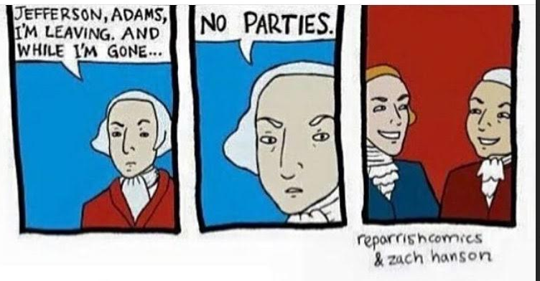
Washington’s Farewell Address

Slide 12
First Political Campaign
Using your notes, the online textbook 4-1, and online resources
Create one of the following to represent one of the lead candidates for president in the 1796 Election:
  Campaign Poster for one Candidate
  30 second speech about why they would be a good Candidate

